Slide 1
Reaching Young Minority MSM with HIV Prevention and Treatment
Marguerita Lightfoot
University of California, San Francisco
2019 Conference on HIV Science

Slide 2
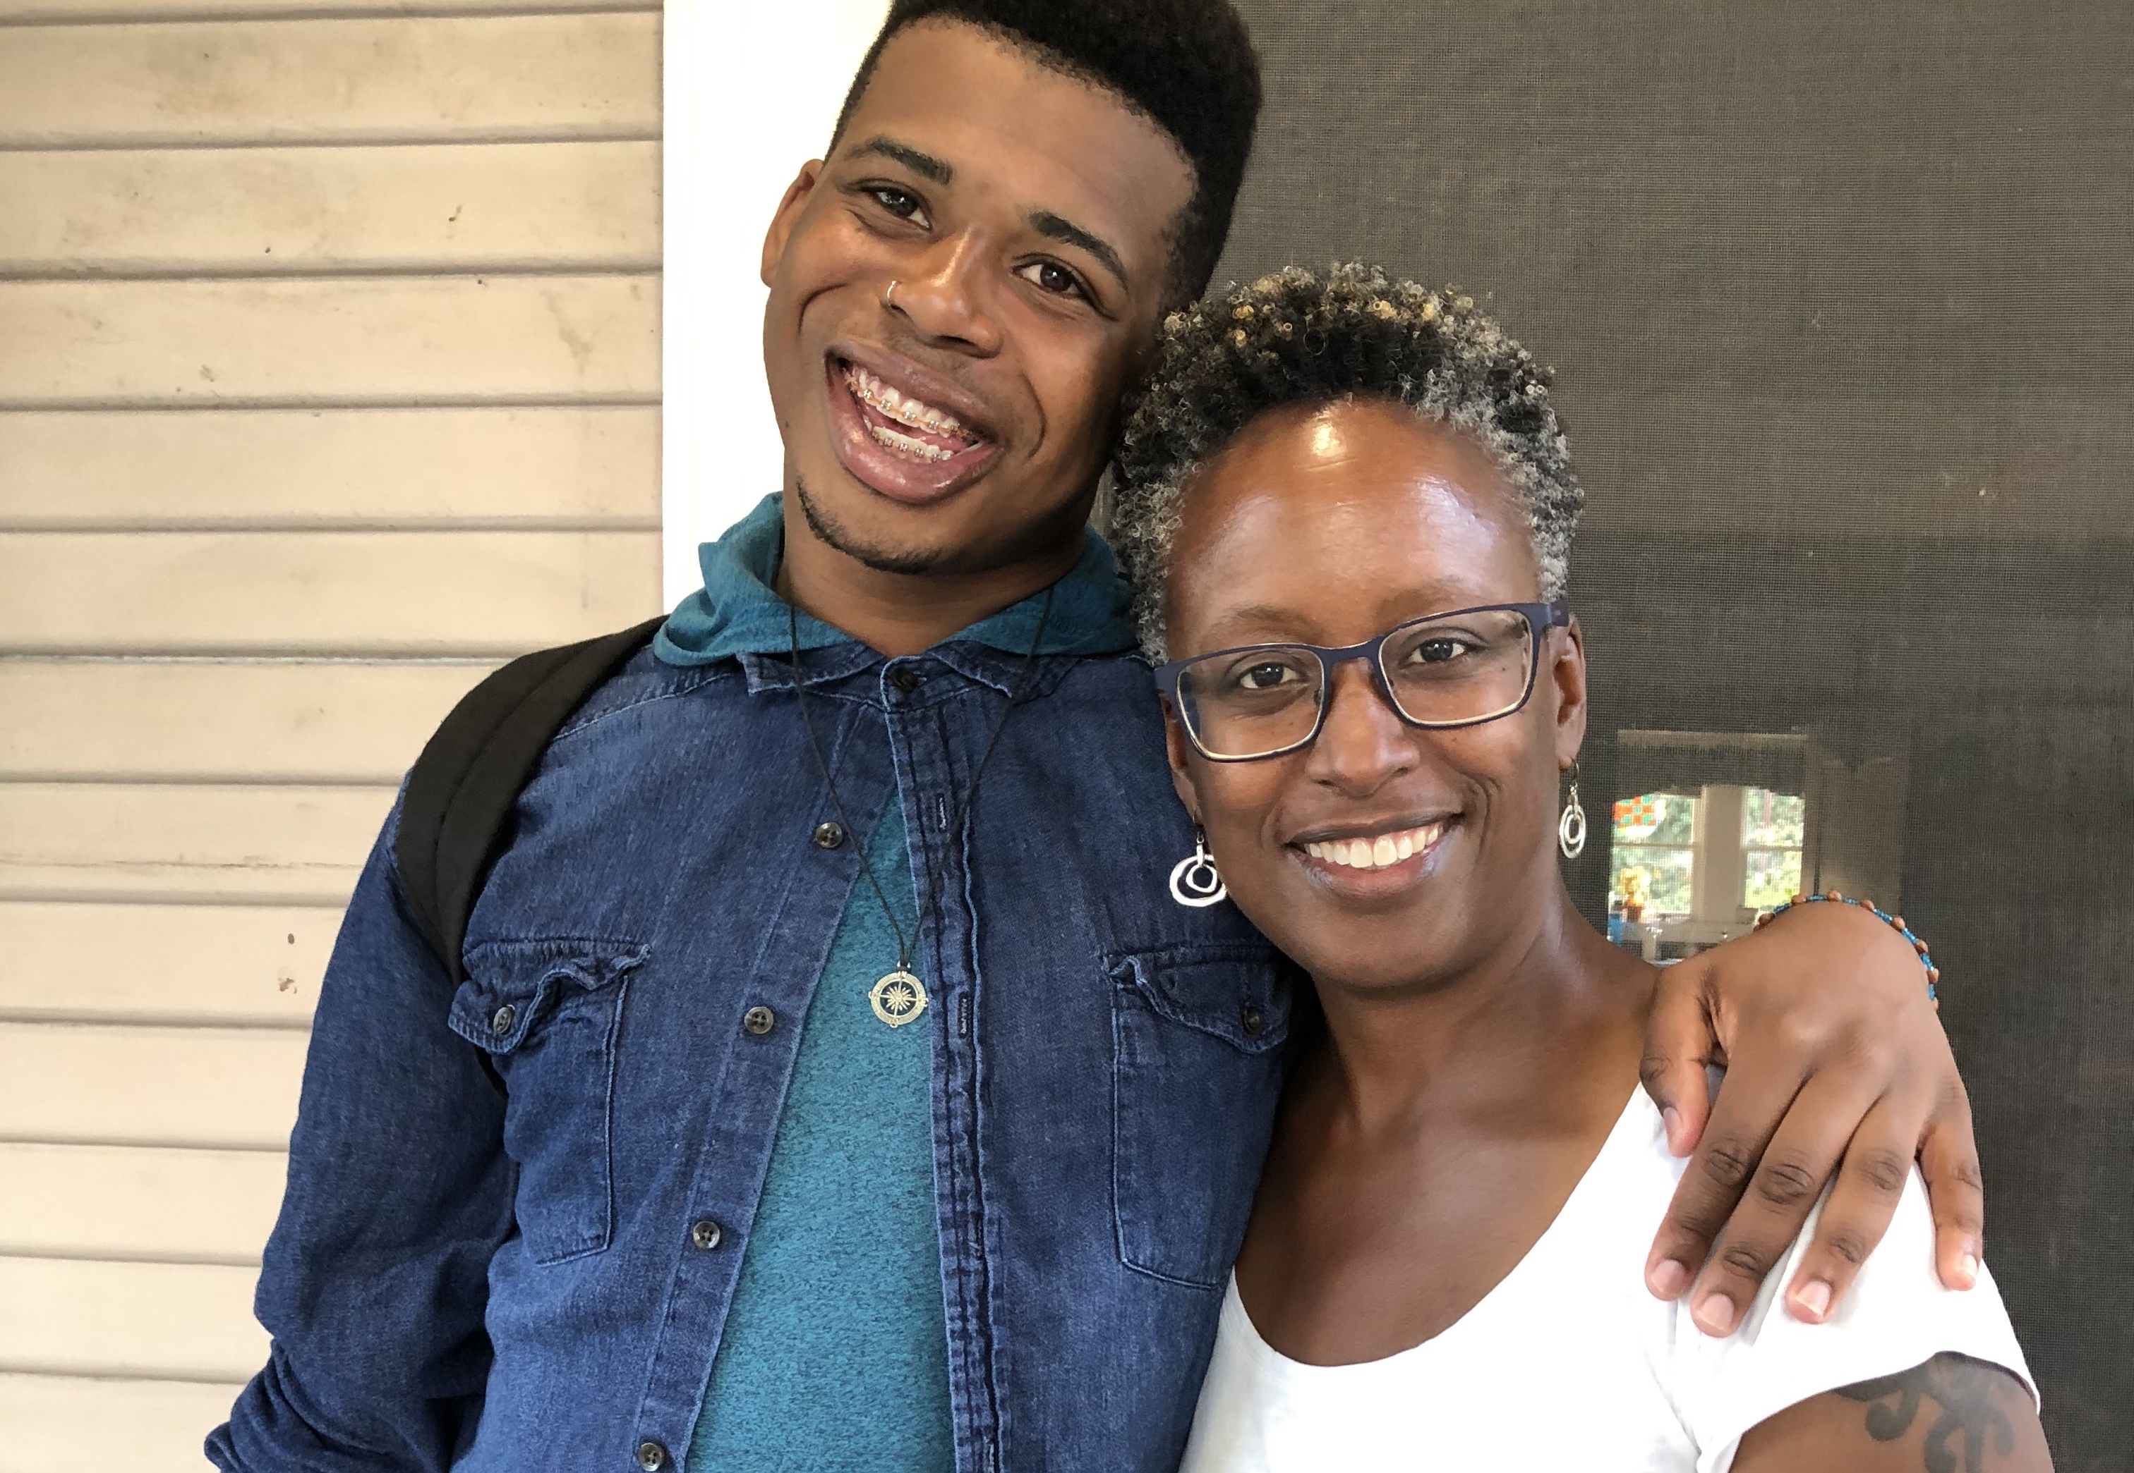

Slide 3
THE TOOLBOX
PREP & PEP
HIV TESTING
01
TREATMENT AS PREVENTION
08
02
STI & DRUG TREATMENT
MALE CIRCUMCISION
07
HIV PREVENTION
03
POWERPOINT TEMPLATE
06
04
BEHAVIOR CHANGE
05
CONDOMS
CLEAN SYRINGES

Slide 4
Overall Men Not Engaged Fully
2017: 21 men on PrEP
Notes:
N= 470 HIV-negative gay or bisexual men who had had sex with another man in last 5 years (87 (15.6%) men who had not had sex with another man in the five years prior to study)
18–25, 34–41, 52–59

Slide 6
Lifetime Risk of HIV Diagnosis among MSM by Race/Ethnicity
Centers for Disease Control and Prevention
Notes:
1 in 11
1 in 4
1 in2

Slide 7
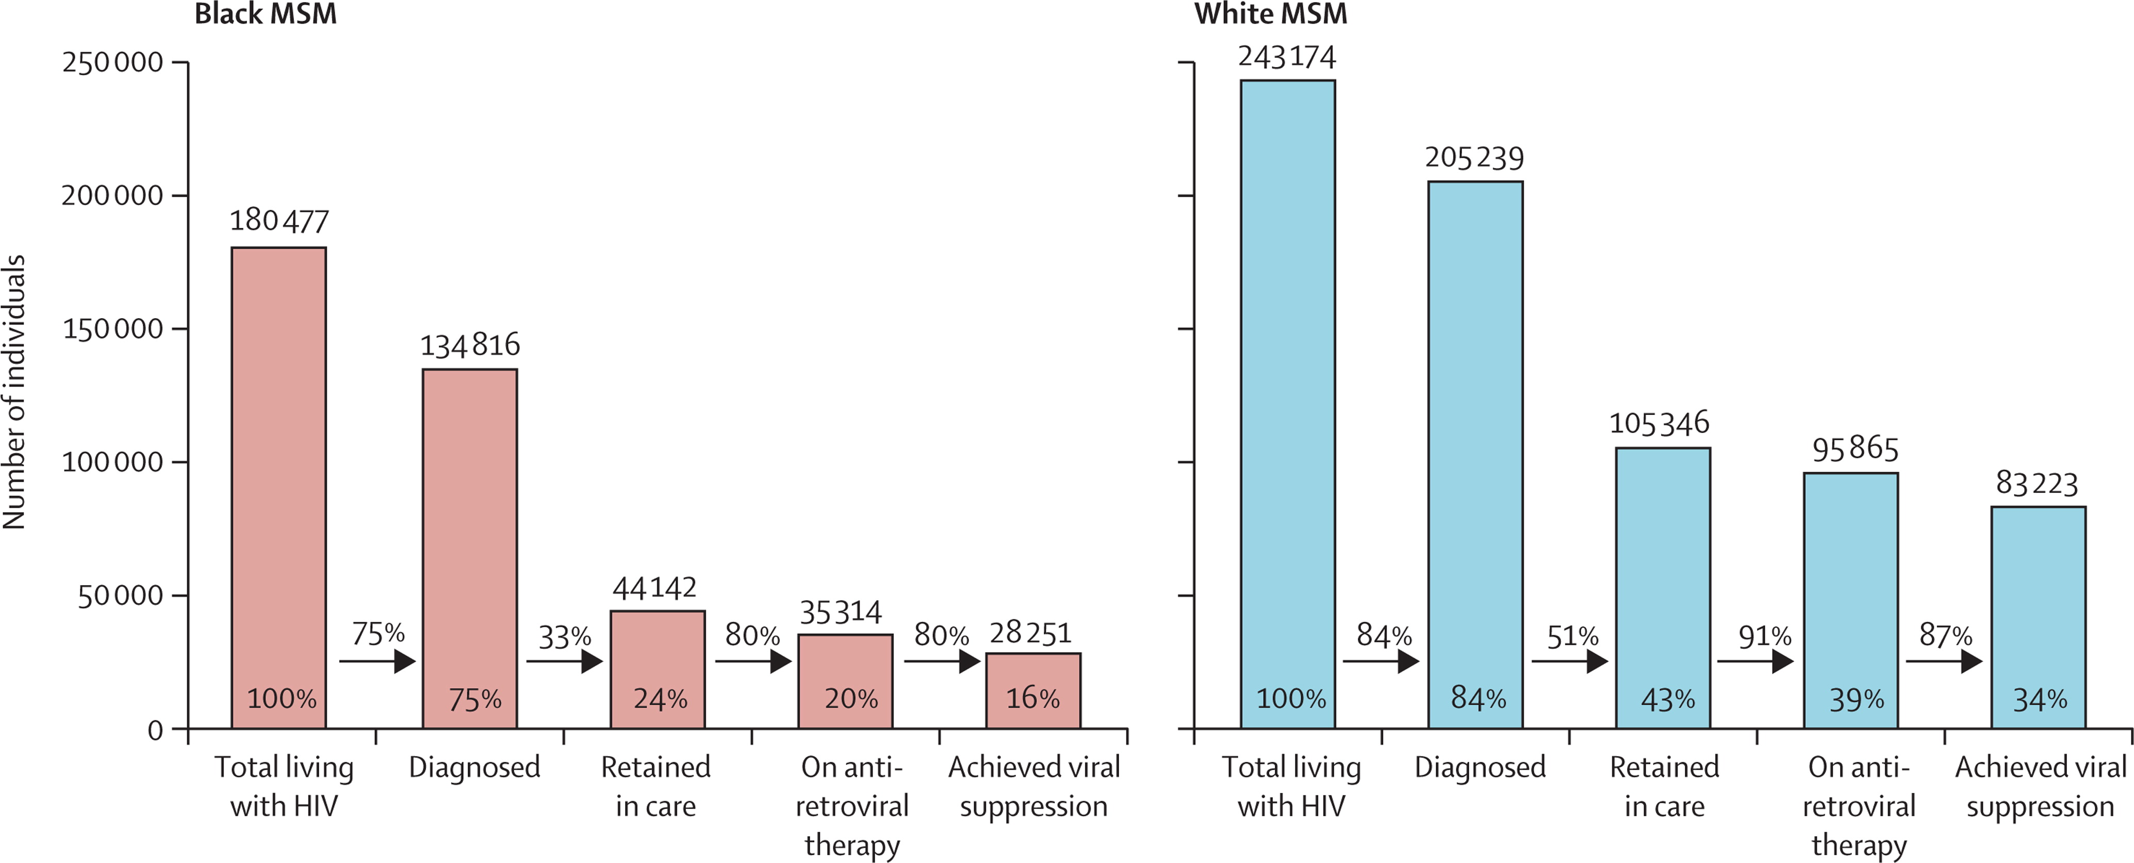
Estimated HIV care continuum for black MSM in the USA during 2009–10
Rosenberg, et al., 2014

Slide 8
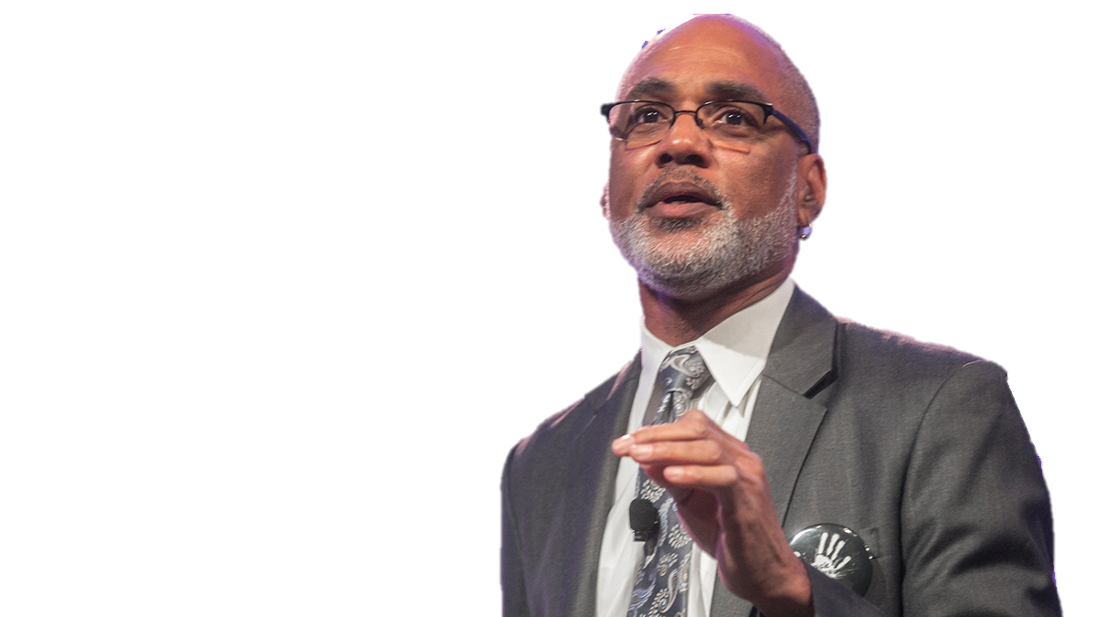
“If you are not successful at ending the AIDS epidemic in Black America, you will not be successful in ending the AIDS epidemic in America”
Phill Wilson

Slide 9
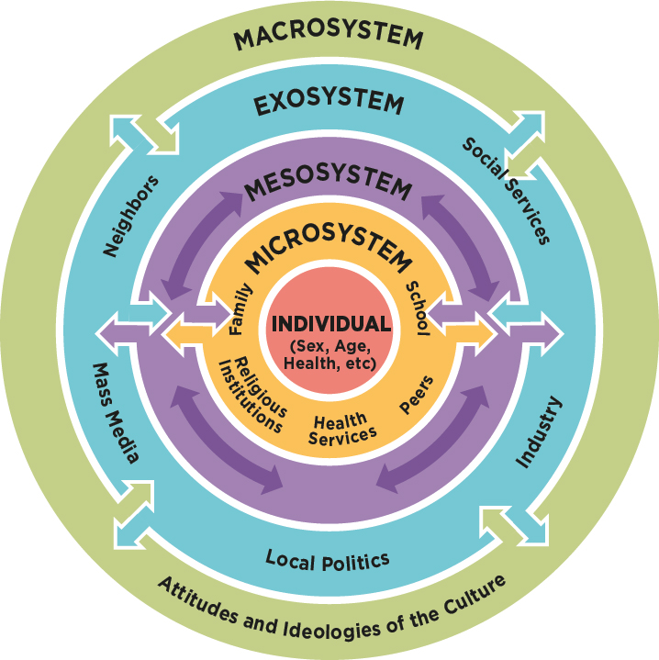
Focus on the Individual

Slide 10
Individual Behavior Doesn’t Explain Differences
Black MSM report less substance use and fewer sexual partners
No significant differences by race Condomless sex
Commercial sex work
Sex with a known HIV+ partner
Notes:
Focus on individual’s cognitions, motivations, intentions, knowledge

Slide 11
Men’s Interactions Reduce Connection
Lack Culturally Competent Care
Privacy Concerns
Lack Affordable Services
Mistrust Medical Providers
Fear
Mental Health & Substance Use
Poor Clinical Encounters
Notes:
46% black, 36% latinx

Slide 12
Providers Are Challenged
Providers reluctant to prescribe
Low willingness and motivation
Racial & substance use stigma
Biased beliefs about Black patients
Heterosexism
Discomfort with discussing sexual behavior
Less likely to recommend appropriate treatment
Verbal communication dominant
Less patient centered communication
Notes:
adherence, intelligence, abilities, cooperative
Latino MSM PrEP users who describe their patient-provider interactions as “condescending” and “awkward” when first accessing PrEP⁵⁴

Slide 13
Inadequate Health Care
Stigma & Discrimination
Uncaring Government
Racism
Gentrification
Incarceration
Notes:
Who measures race? Who measures stigma? Who measures racism?

Slide 14
More we can do
Racism and Stigma
Theoretical Considerations
Structural Interventions
Notes:
NIH won’t be paying to dismantle institutional racism and white supremacy, but I don’t need you to do that. I’ve been teaching my son to deal with racism, as my parent’s did before me. don’t intervene with me on my depression without acknowledging I have good reason to be depressed
Intersectionality help understand the complexity, Critical race theory
Because black folks are hanging out with each other, that’s the problem. Be careful, don’t take that away
Interventions – provider training, not gonna fix poverty, but workforce development, post incarceration programs, faith based initiatives/spirituality, stable housing, healthcare coverage

Slide 15
To reach minority MSM we must stop blaming them, understand their life in context, and address broader system factors

